Slide 1
Enhancing Reinforcement Learning Using DQN with Distributed Training for Taxi and Cartpole
By Liza Trundle, Ann Li, Bailey Phillips, and Shelton Kwiterovich
Notes:
Bailey

Slide 2
Table of Contents:
Introduction/Background
Problem Statement
CartPole Background and Results
Taxi Background and Results
Conclusion
Notes:
Bailey

Slide 3
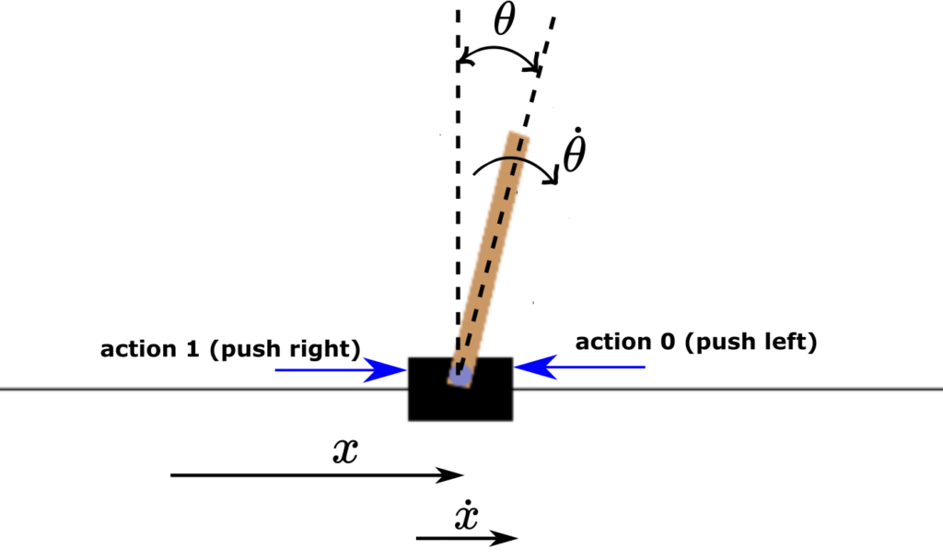
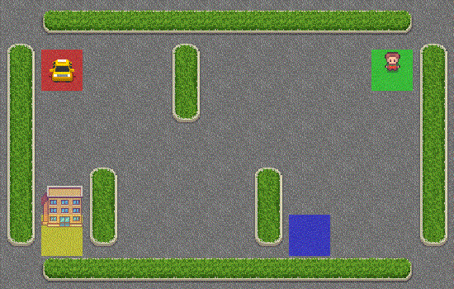
Introduction:
This project aims to extend RL capabilities from assignment 3 to effectively play different games than Lunar Lander, focusing on the Taxi and Cartpole environments.
Notes:
Bailey:
As a quick introduction, this project aims to extend the reinforcement capabilities from Assignment 3 in which we focused on using ray and dqn for the Lunar Lander game. However, in this project, we are focusing on Taxi and CartPole games and fine tuning the hyper parameters to achieve optimal and efficient training times.

Slide 4
Problem Statement:
Problem statement = To develop RL models that excel at these games while optimizing resource usage, leveraging distributed training with Ray to parallelize computation, and achieving higher average rewards and improved training stability.
Achieved this by experimenting with fine tuning parameters as well as testing game play with different number of VMs
Notes:
Liza:

Slide 5
Games Under Analysis:
In this next section, we will talk about the games we decided to analyze.
Notes:
Liza:

Slide 6
Cartpole-v1
Notes:
Liza:

Slide 7
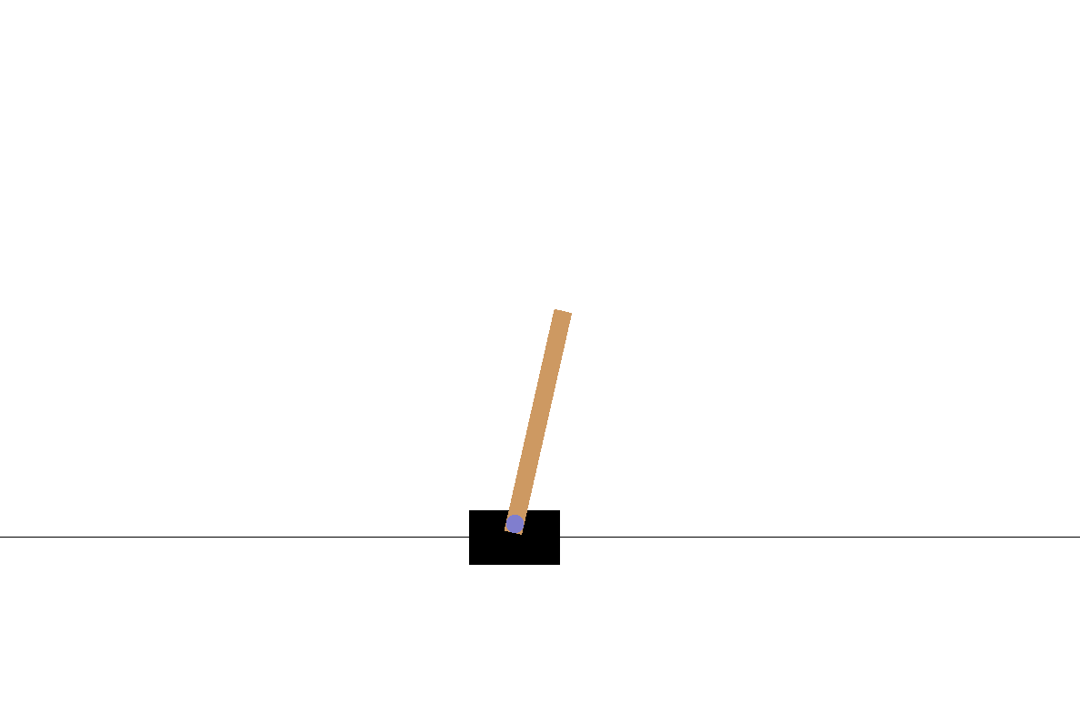
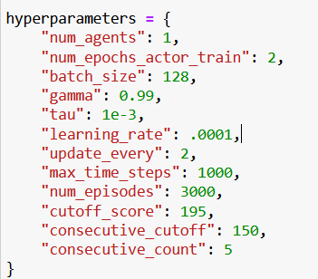
CartPole Background:
Goal: Since CartPole is a simple game, we wanted to see how efficient we can make the training time with regards to the least amount of resources/vms.
Set Up:
Adapted assignment 3 code for new environment
Altered state size to 4 and action size to 2
Added code to save each run to a json file
Added code to ensure average scores were consistent
Added code to graph different runs
Altered each hyperparameter and watched training time
Adjusted Hyperparameters:
Started to fine tune hyperparameters and noticed that changing num_epochs_actor_train and batch_size had a considerable effect on training time
Most likely due to simplicity of the game
Other adjusted parameters: Learning_rate, Update_every, num_agents
Notes:
Liza:

Slide 8
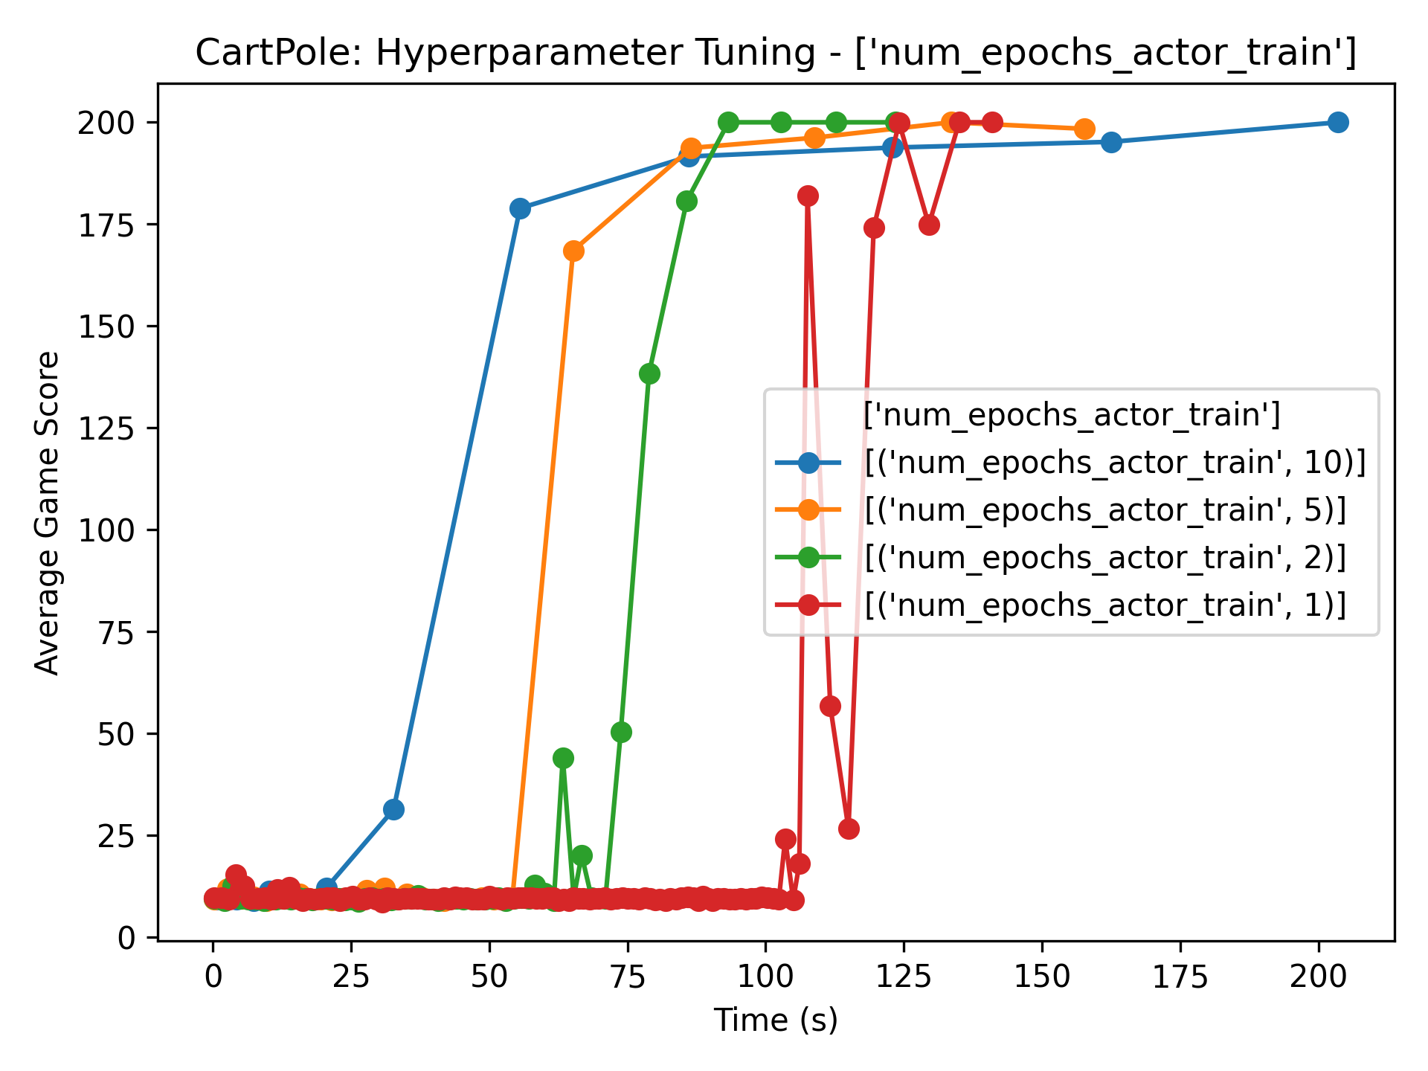
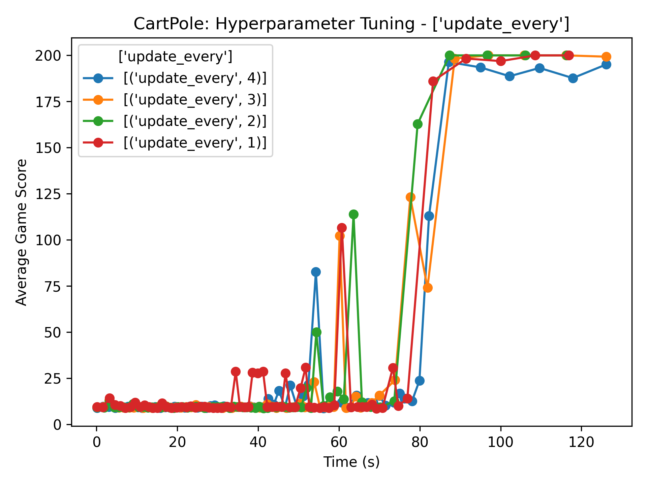
Distributed Learning Tuning: Num_epochs and Update_every
Num_epochs_actor_train
CartPole was converging quicker than anticipated
Therefore, by running extra epochs, CartPole was taking extra time for updates and computations
Due to this, by decreasing num_epochs, each agent was synchronizing with GlobalNet faster
1 epoch hurt training time as model had less opportunity to learn from data
Update_every
CartPole has a small state space and is relatively stable environment
With more frequent updates, agents can learn from experiences quicker and are less likely to destabilize the learning process
Notes:
Liza:

Slide 9
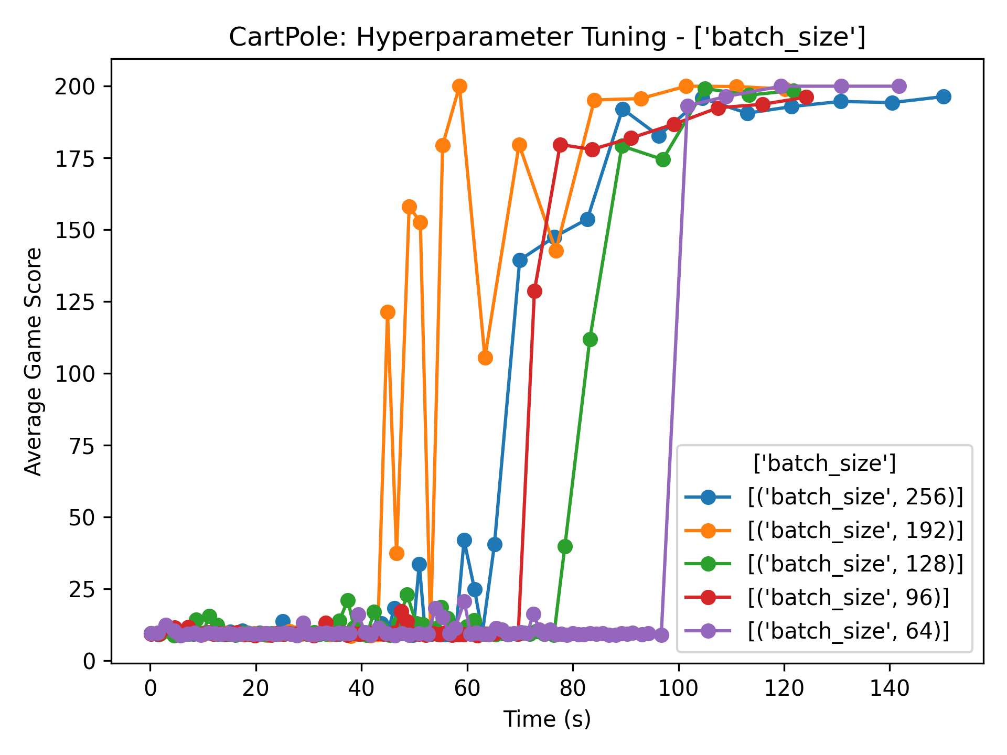
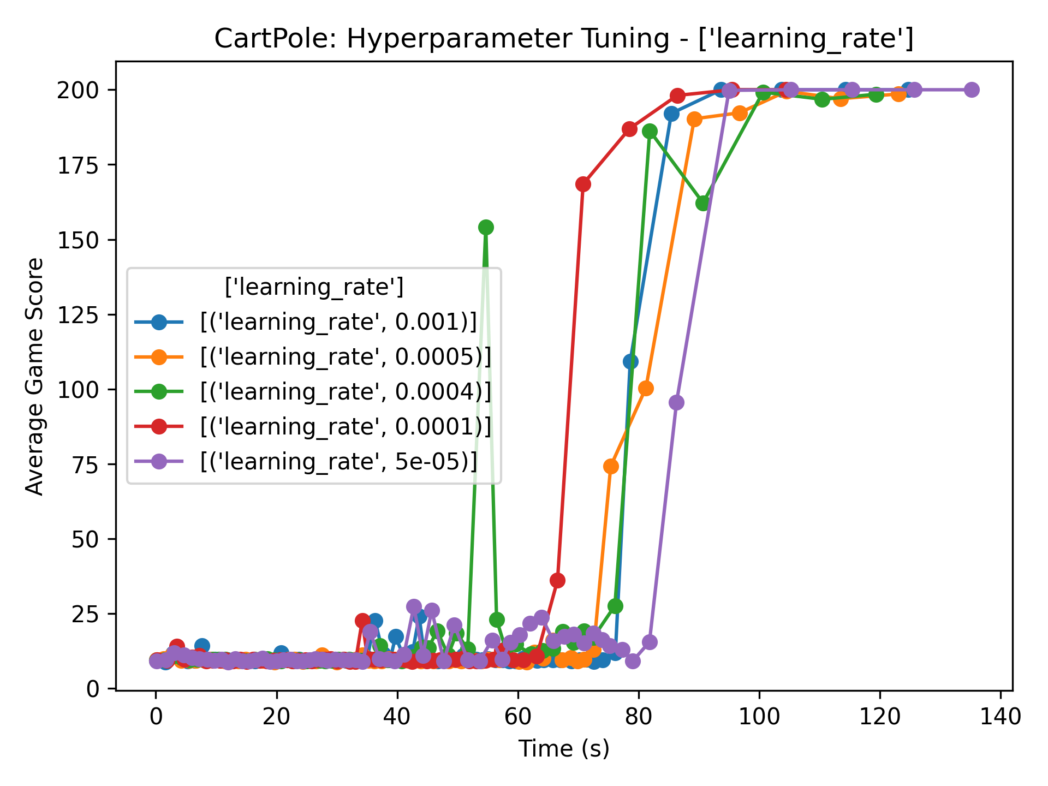
Distributed Learning Tuning: Batch_size and Learning_rate
Batch Size
By using a larger batch size, the gradient estimate becomes a better representation of the overall population (by sampling more experiences)
CartPole is not as volatile/complex so outliers are not as paramount
Learning Rate
Since we used a larger batch size, each update contains more information about the dataset
With a smaller learning rate, we can have more efficient update
A smaller learning rate can also lead to fewer updates
Notes:
Bailey:
The next two hyperparameters we tuned were the batch size and learning rate. As shown on the left graph, the most efficient training time was achieved with a batch size of 128 (the green line). We hypothesize that this occurred due to how simplistic and non volatile the CartPole environment is. By utilizing a larger batch size, we are able to have a better representation of the overall population in terms of our gradient estimate and therefore cause more stable learning. This allows any outlier data points to not mess with the learning stability as we are averaging more experiences at once. The next hyper parameter we fine tuned was the learning_rate. Since we used a larger batch size, each update contains more information about the dataset. Consequently, we are able to utilize a smaller learning rate as we can have fewer and more efficient updates. As shown in the graph, the learning rate of .0001 (red line). led to the lowest training time.

Slide 10
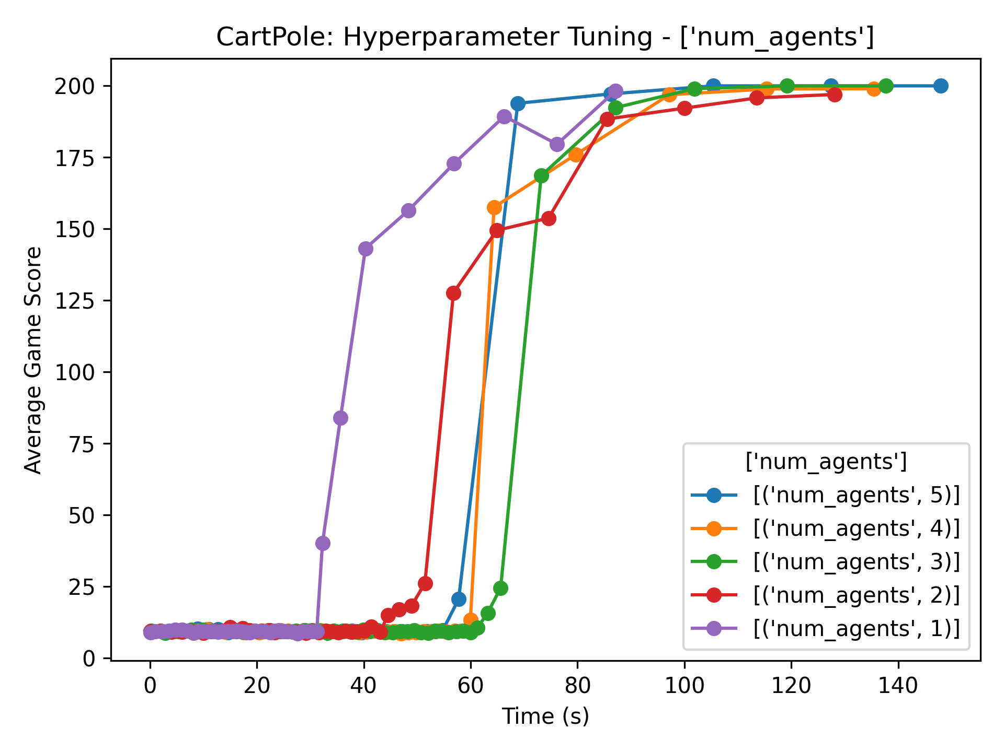
Distributed Learning Tuning: Num_agents
Num_agents:
With less agents, there is less computational overhead
Less redundant exploration and the agent can explore state space at a slower rate
Better sample efficiency since CartPole environment is relatively stable and simple
With less agents, each agent receives a larger share of total experiences → more effective learning
Notes:
Bailey:
The final hyper parameter we fine tuned was the number of agents as we wanted to see how efficient we can solve the Cart Pole environment with the least amount of resources (in this case VMs). As shown in the graph, with only 1 agent (the purple line) and using 2 VMs (with 2 CPUs each), we were able to achieve the quickest overall training time. This can be due to less computational overhead by using less agents and how the singular agent receives a larger share of total experiences to explore the state space at a slower rate. This leads to more effective learning.

Slide 11
Data Comparisons
Default Params
Fine Tuned Params
Epochs = 10, Batch = 64, Learning rate = 5e-4, Update_every = 4, agents = 4
Environment solved in 110 episodes!
Total duration: 384.22 seconds
Average time for training: 3.40 seconds
Average time for updating: 0.02 seconds
Average time for synchronizing: 0.02 seconds
Epochs = 2, Batch = 128, Learning rate = 0.0001, Update_every = 2, agents = 4
Environment solved in 440 episodes!
Total duration: 135.51 seconds
Average time for training: 0.26 seconds
Average time for updating: 0.02 seconds
Average time for synchronizing: 0.02 seconds
Fine Tuned Params and VMs
Epochs = 2, Batch = 128, Learning rate = 0.0001, Update_every = 2, agents = 1
Environment solved in 410 episodes!
Total duration: 100.59 seconds
Average time for training: 0.21 seconds
Average time for updating: 0.01 seconds
Average time for synchronizing: 0.01 seconds
Notes:
Bailey:
This slide goes over the data comparisons of each hyper parameter combinations we studied. The default combination took 384.22 seconds to solve the environment while the fine tuned hyper parameters combined with 2 VMs with 1 agent only took 100.59 seconds to solve.

Slide 12
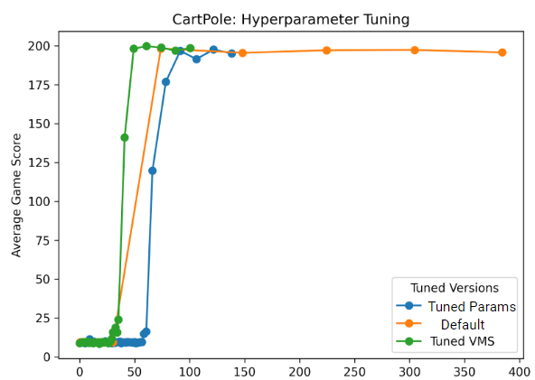
CartPole Data Analysis:
CartPole Conclusion:
Optimal performance with 2 VM’s and 1 agent and fine tuned parameters – fine tuning reduced training time
3.81x speed increase compared to default settings
CartPole's simplicity allowed efficient training with minimal resources
Notes:
Liza:

Slide 13
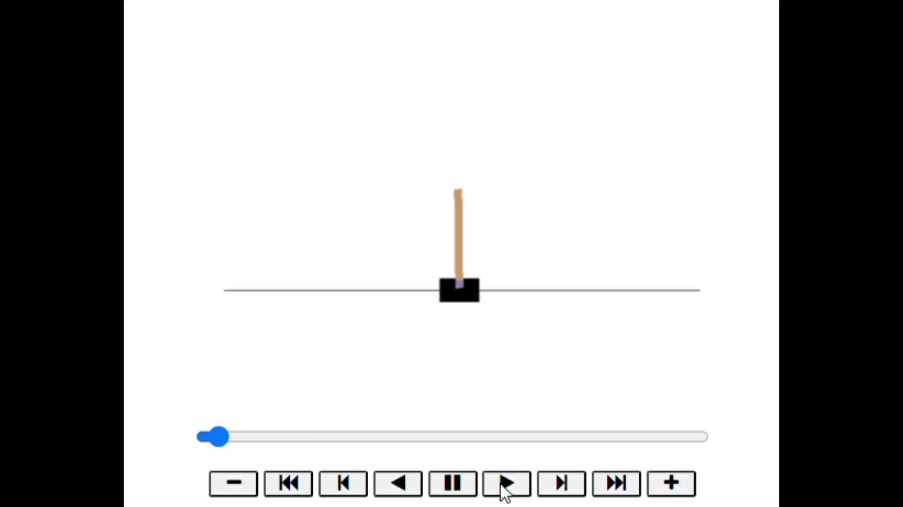
Demo of CartPole:
** video is running on 2x speed
Notes:
Liza:
We will now show you a demo of the CartPole gameplay using dqn and ray…

Slide 14

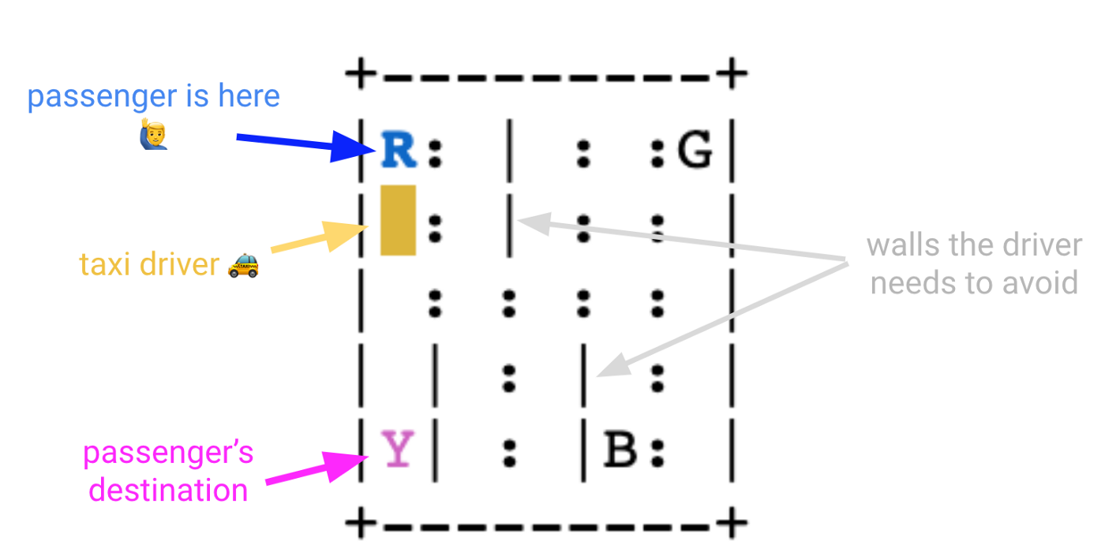
Taxi-v3
Notes:
[Shelton]

Slide 15
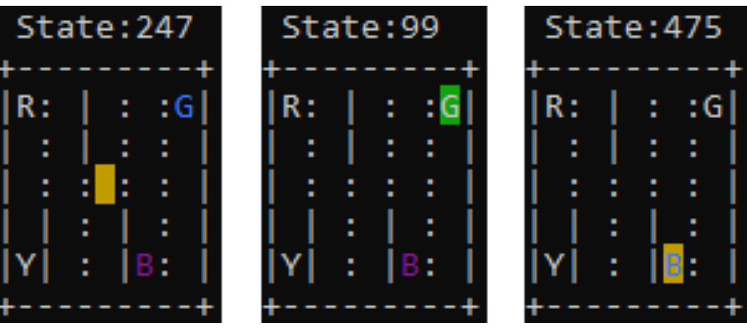
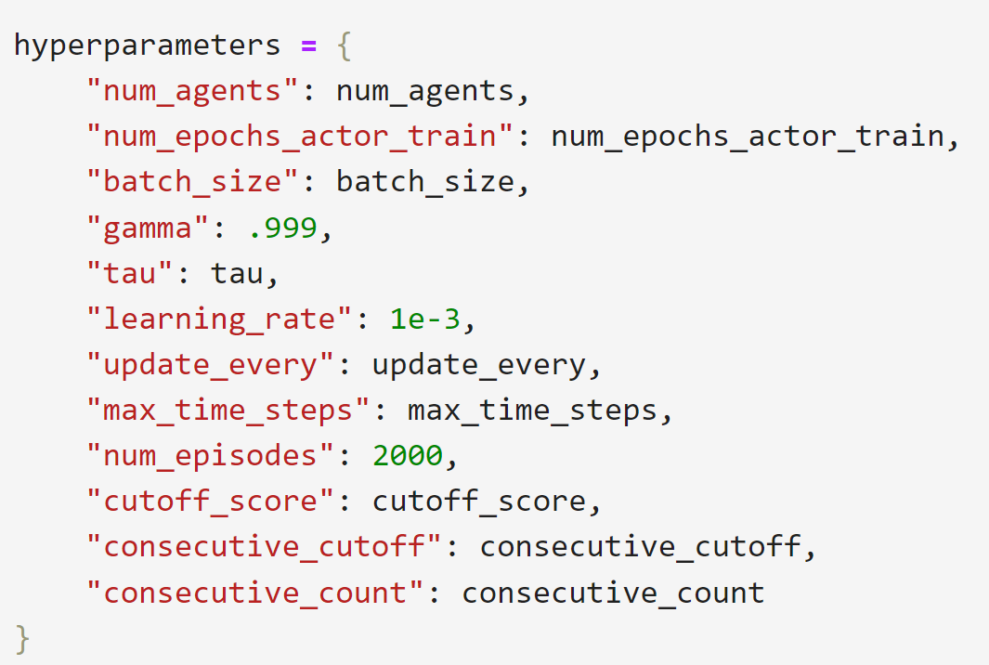
Taxi Background:
Set Up:
State space 500 | Action space 6
Tuned machine learning parameters (learning rate, gamma, tau)
Tuned distributed learning parameters (epochs, agents, and batch size )
Hyperparameters
Default parameters
Same as Assignment 3
ML tuned parameters
Changed: Gamma, Learning Rate, Tau
DL tuned parameters
Changed: Number of Epochs, Batch Size, Number of Agents
Notes:
[Shelton]

Slide 16
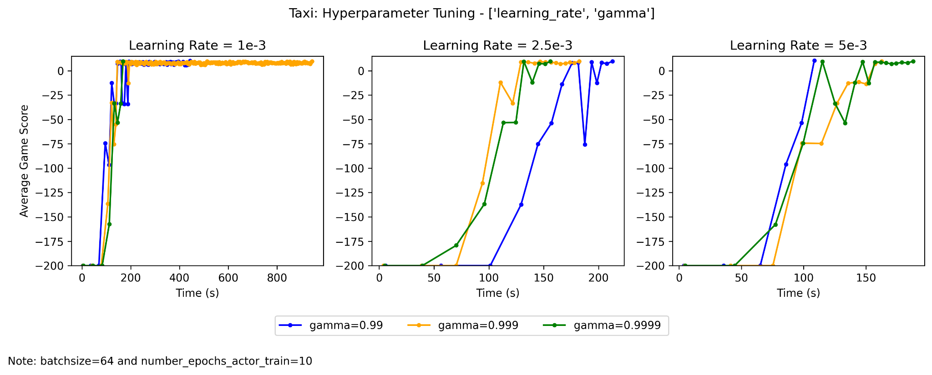
Machine Learning Tuning: Learning Rate + Gamma
Notes:
[Ann]
Worked with tau (controls soft update of parameter), gamma (discount factor), and learning_rate ⇒ found nothing for tau
Describe plots (9 combos of learning_rate + gamma, each plot split by learning_rate)
As learning rate increases, training smoothes out (and tends to take less time)
Influence of gamma less clear: high gamma worked well for 2.5e-3, but less well for 5e-3
Three combinations of machine learning parameters that worked well (in next plot)

Slide 17
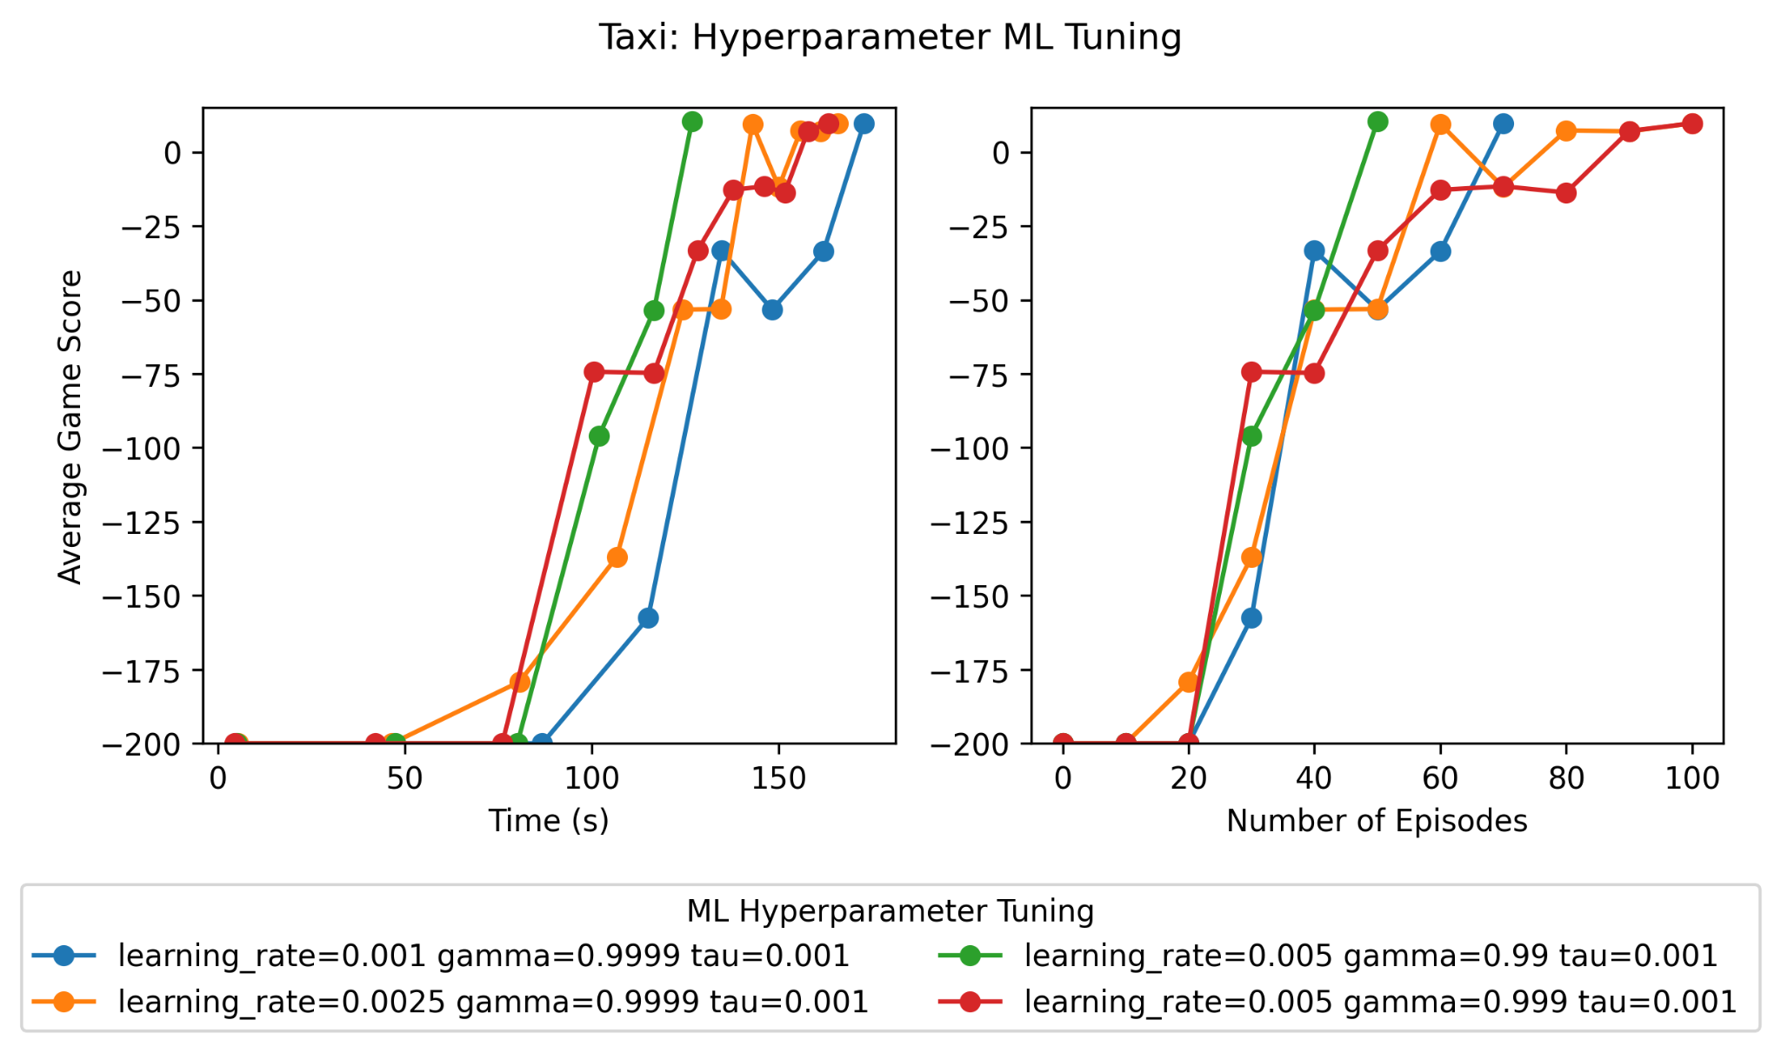
Machine Learning Tuning: Best Combinations
Notes:
[Ann]
One did really well → misleading performance actually
No clear pattern (different combos)
Larger learning rates tend to be good
Smooth (few dips in game score)

Slide 18
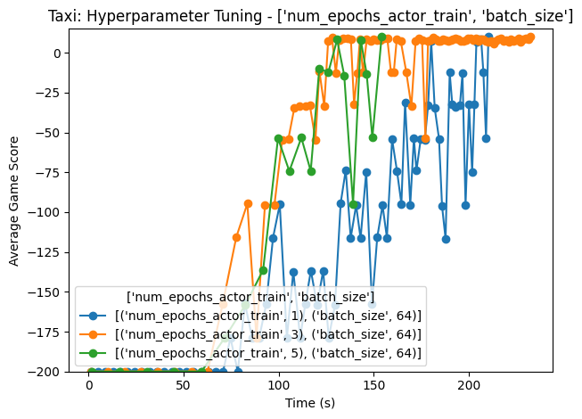
Distributed Learning Tuning: Number of Epochs
Fastest runtime:
Batch size 64
& 5 epochs
Notes:
[Shelton]
hyperparameters = {
"num_agents": 4,
"num_epochs_actor_train": 1,
#3
#5
"batch_size": 64,
"gamma": 0.99,
"tau": tau,
"learning_rate": 1e-3,
"update_every": update_every,
"max_time_steps": max_time_steps,
"num_episodes": 2000,
"cutoff_score": cutoff_score,
"consecutive_cutoff": consecutive_cutoff,
"consecutive_count": consecutive_count
}

Slide 19
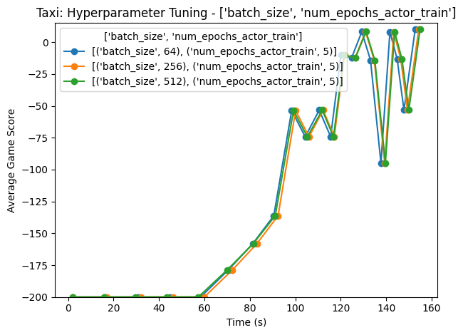
Distributed Learning Tuning: Batch Size
Batch Size has no effect on runtime with these parameters
Notes:
[Shelton]
hyperparameters = {
"num_agents": 4,
"num_epochs_actor_train": 5,
"batch_size": 64,
#256
#512
"gamma": 0.99,
"tau": tau,
"learning_rate": 1e-3,
"update_every": update_every,
"max_time_steps": max_time_steps,
"num_episodes": 2000,
"cutoff_score": cutoff_score,
"consecutive_cutoff": consecutive_cutoff,
"consecutive_count": consecutive_count
}

Slide 20
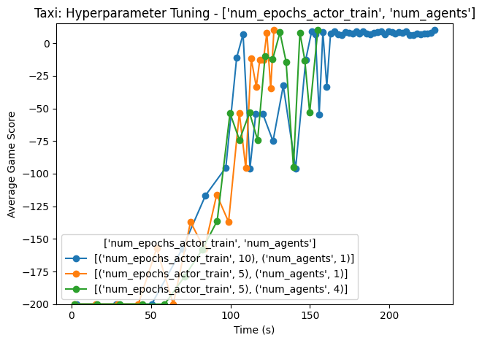
Distributed Learning Tuning: Number of Agents
Fastest runtime:
5 epochs &
1 agent (2 cpus)
Notes:
[Shelton]
Cpu = 2 for all runs
hyperparameters = {
"num_agents": 1,
"num_epochs_actor_train": 5,
"batch_size": 64,
"gamma": gamma,
"tau": tau,
"learning_rate": 1e-3,
"update_every": update_every,
"max_time_steps": max_time_steps,
"num_episodes": 2000,
"cutoff_score": cutoff_score,
"consecutive_cutoff": consecutive_cutoff,
"consecutive_count": consecutive_count
}

Slide 21
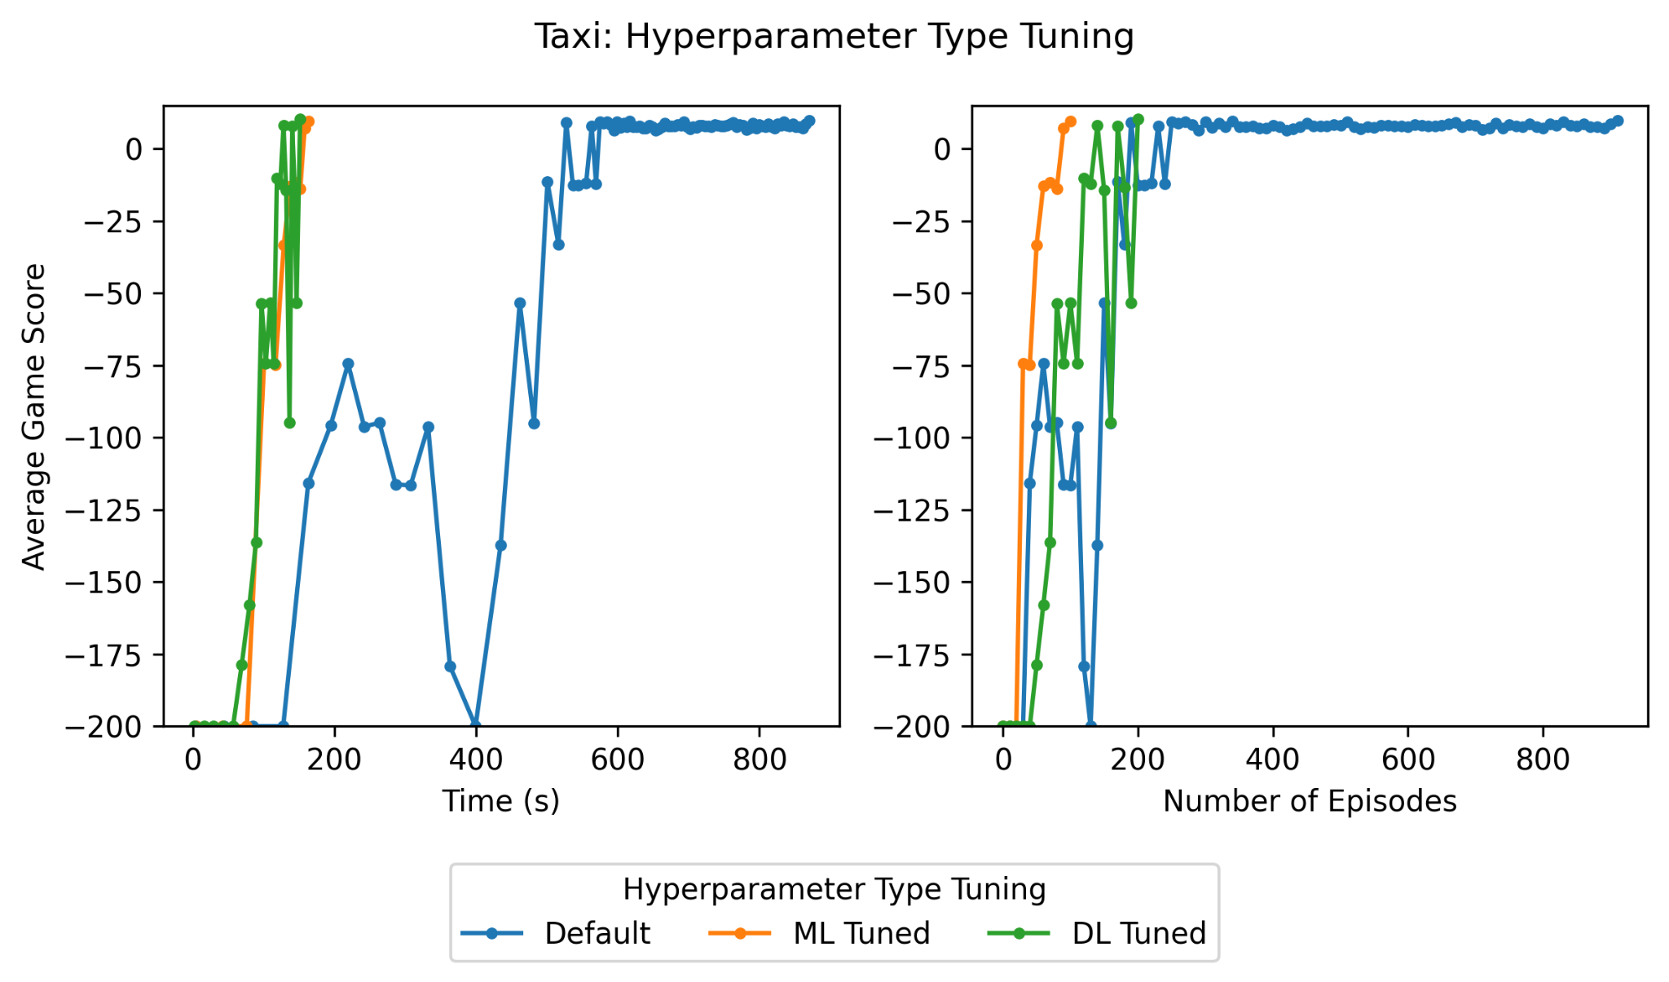
Hyperparameter Tuning: Default v. Tuned
Notes:
[Ann]
Compared to the default, both the ML + DL tuning do much better
Significantly smoother
Some variations in distributed learning tuned version, but still much better than default
Shows that tuning either set of parameters can significantly improve performance!

Slide 22
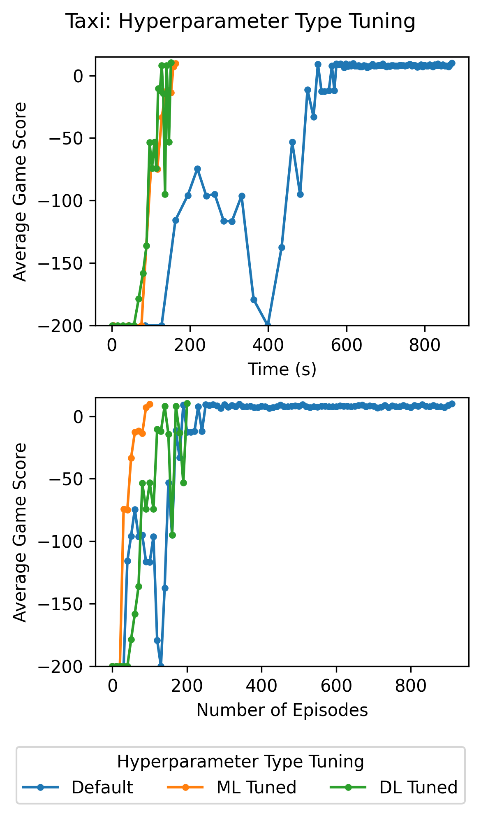
Taxi Results:
Results:
Significant improvement in training time and smoothness after tuning either distributed learning or machine learning parameters
Analysis:
Can achieve similar performance by tuning either distributed learning parameters, or machine learning model parameters
Notes:
[Ann]
We saw significant improvement overall through tuning

Slide 23

Demo of Taxi:
** video is running on 2x speed
Notes:
[Ann]

Slide 24
Conclusion:
Leveraged distributed training with Ray to parallelize computation for Taxi and CartPole
Identified a cost effective and efficient hyperparameter configuration for CartPole
Improved the efficiency of training through distributed learning and machine learning tuning for Taxi
Overall, we optimally solved Taxi and CartPole using DQN and Ray, with a focus resource usage

Slide 25
Thank You for Watching!

